Slide 1
Online Orientation

Slide 2
House Rules and Information
Please mute yourselves.
Type any questions you have on the chatbox.
For registration purposes, kindly mention your correct details in the link as provided.
Kindly note that this session is recorded and if you have any objections, please let us know.
Please also note that we will be sharing the presentation to you later as well which will be for
your reference
After this orientation, you will be assigned with a British Council School Ambassadors( BCSAs) to help with any queries you might have.
Notes:
Before we begin, I would like to take you through the house rules of this online orientation. Everyone present here is requested to follow these rules so that we can run this orientation very smoothly.

Slide 3
What is Connecting Classrooms through Global Learning (CCGL)?
Connecting Classrooms through Global Learning (CCGL) supports teachers and school leaders to improve teaching giving students the knowledge, skills and attitudes they need to make a positive contribution now and in the future.
Our strands are:
Teacher and School Leader Professional Development
International School Award Programme
Professional Partnerships
Policy Level Engagement
For more information of CCGL in Nepal go to our website www.britishcouncil.org.np
Notes:
Connecting Classrooms in Nepal started in the year 2012 and is a program co-funded by DFID and the British Council. This is the 4th phase of the program and is called Connecting Classrooms through Global learning or CCGL. Connecting Classroom program aims to support teachers and school leaders to improve quality in education to improve knowledge, skills and attitude required for the 21st Century

Slide 4
International School Award
The British Council International School Award(ISA)is a benchmarking scheme that accredits schools as having an outstanding level of support for nurturing global citizenship in young people and enriching teaching and learning experiences.
Endorsed by Center for Education and Human Resource Development (CEHRD)
Notes:
So, ISA is a benchmarking scheme which means it set a higher standard of teaching and learning at your school and supports to develop global citizens in young people and enrich teaching and learning. So yesto khal ko ata program ho ISA jasle teaching learning shaili haru ma pariwartan lera aauncha ra students haru lai 21st century ma chahine skills dincha.
Can anyone say what is ISA?

Slide 5
Enriched Teaching and Learning
Students work on projects that make learning deeper and more meaningful for them
Students collaborate with peers in different countries that help them to engage positively with global issues.
Professional Development for teachers and School Leaders
- Teachers and School Leaders get to collaborate with peers around the world exchanging best practice cases and learning from each other.
Notes:
So why ISA?

Slide 6
British Council School Programme
ISA is now active in 35+ countries including:
► Bangladesh ► Pakistan ► Nepal India
► Vietnam ► Taiwan ► Nigeria Sri Lanka
► Poland ► Greece ► Jamaica
► Bahrain ► Egypt ► Saudi Arabia
Notes:
These are the countries that have already started ISA.
Any questions ?

Slide 7
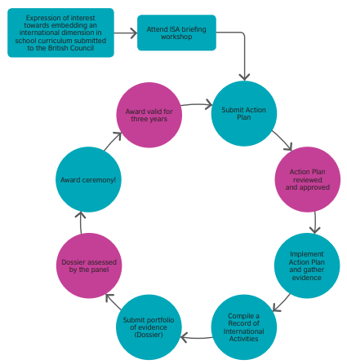

Slide 8
The Award
Accreditation for three years
Trophy, certificate and use of logo on school website, stationery & promotional material
Acknowledgement from peer group of educators, Ministry of Education & British Council of high standards of international work
Awards presentation ceremony with networking opportunities
Accredited schools can get a chance to become “ambassadors” to support other schools
Notes:
The Award. So, the ISA accreditation is for 3 years. You will receive a trophy, certificates and ISA Kite marks or Logos to use on your school’s website, stationaries or any promotional material. The ISA award is endorsed by the CEHRD and you will receive an award also endorsed by the government. Schools gets wider networking opportunity in this journey and also a chance to apply for British Council School ambassador role to support other schools.
Any questions ?

Slide 9
Types of ISA projects
3 Collaborative projects
2 In school projects
20% Local Curriculum project
With an International partner
With an International Dimension
With an International Dimension
1 Public private partnership project
With an International Dimension
1+ Supplementary Project
Notes:
The ISA program consists of the following types of projects. You will have to complete all these in order to receive the award. You will have to do 3 collaborative projects with an international partner school around the globe. Any country in the world whether they are currently doing the ISA or not. You also have to do 2 In school projects with an international dimension. About understanding international dimension and its meaning, we will come back to this later in the session. You are also required to create one 20% Local curriculum of your own with an international dimension in it. There is a separate session on 20% Local curriculum project which we will discuss later. Then you require to create 1 public- private partnership project also with an international dimension in it. This means if you are a public school, you will collaborate with a private school and work together on this project and if you are a private school, you will work with a public school to complete a project. So these are the 7 projects that are mandatory. 3 Collaborative project, one public-private project, one 20%LC project and 2 in school projects. Besides these, you could do supplementary projects as many as you can. Supplementary projects can be of any type

Slide 10
Questions/Break

Slide 11
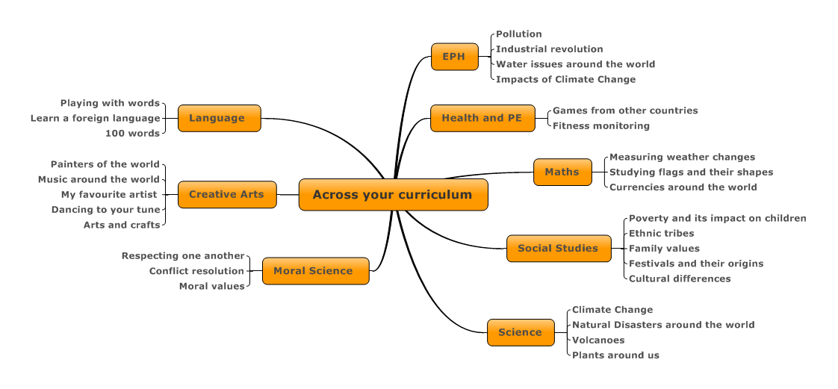
Notes:
So for any types of projects that we discussed earlier, we can use various subjects to create one project. So if you see the curriculum of these subjects, you will know that these are some examples of many topics which can be used to create a project. You could create a project using mathematics, creative arts, science, English to form a project. A project is designed by bringing some curricular context together of 2 or more subjects and creating cross curricular activities around those in order to teach all these areas of various subjects by engaging students practically. For example: A project named ‘Festival around the World’; It could be designed with subjects like social studies, Maths, English, Nepali and Science . This project will teach about festivals naturally from the social studies curriculum. Suppose we are talking about Dashain, then in Dashain, we plant Jamara. The germination process of Jamara is linked with science where students can learn about germination of the plant and its stages, chlorophyll, etc. Dashain also has Kite flying which could easily teach height and distance of Mathematics and shapes of the kites could be used to teach Geometry. Making a kite is itself using Creative Arts. Students could be taught to design their own kites. Also If the students can write an essay in either Nepali or English about festivals then these essay writing topics of English and Nepali can also be taught. The students can learn about Dashain celebrated in other countries as well and they will find out that in India, they celebrate Dashain but its only for 3 days and we celebrate for 9 days. They learn about similarities and differences between the two countries and ways we celebrate the same festivals. Students could also learn that the same character Ravan who is seen as demon in India is worshipped in Sri-Lanka. These topics also brings out global outlook for the students and makes a student search for more answers building their curiosity and making them a global citizen by learn from around the world. So a project should be such that 2 or 3 subjects be covered and students engaged through it. We will have a look at various examples later today.
Any questions ? Again too much information. I think quote one example and make the rest available as an offline resource.

Slide 12
Action Plan

Slide 13
Why is the Action Plan important?
It’s the blueprint of the ISA activity to be carried out by the school during the year
Once approved by the Assessment Panel, it has to be adhered to
The final dossier is assessed against the approved Action Plan

Slide 14
What is an Action Plan?
Portfolio of 7 mandatory and upto 1 supplementary project.
3 collaborative projects with international partners.
One 20% local curriculum project, 2 in-school projects, 1 public-private partnership project.
All projects need to have an international dimension
At least one project needs to have an activity on language learning
Notes:
Refer to pages 8 & 9 in the Guidance Manual
Discuss the
Audit Template
Sara Bubb 30/06/2016
Seems
odd just to have 2 steps
Sara Bubb 30/06/2016
Is this correct?

Slide 15
What is an Action Plan?
The Action Plan needs to cover at least 80% of the academic year
The Action Plan needs to involve at least 75% of the students.
Projects may involve students of a single grade or multi grades
Projects have to be based on the curriculum and may cover one subject or more than one
Should incorporate at least an SDG (the UN’s sustainable development goal)

Slide 16
Sample of a project

Slide 17
What is International Dimension?
Giving our pupils knowledge about other countries and cultures

Slide 18
UN’s Sustainable Goals For more Info : https://www.youtube.com/watch?v=pgNLonYOc9s
https://www.un.org/sustainabledevelopment/sustainable-development-goals/

Slide 19
Create a clear connection ……
Learning Outcome
Curriculum
Activity Stages
Assessing Tools

Slide 20
Designing an ISA project
How to ensure we have effective project built
Formation of the project requires the right team.
ISA coordinator’s job is to bring relevant subject teachers together and plan the project along with the team.
A good project is prepared by looking at the content of the curriculum of each subjects which are to be included and deriving relevant activities to meet the stated Learning Outcome of the curriculum.
Considering timelines and age groups to be involved in the project.
Discussion between teachers should happen on how to evaluate students learning.

Slide 21
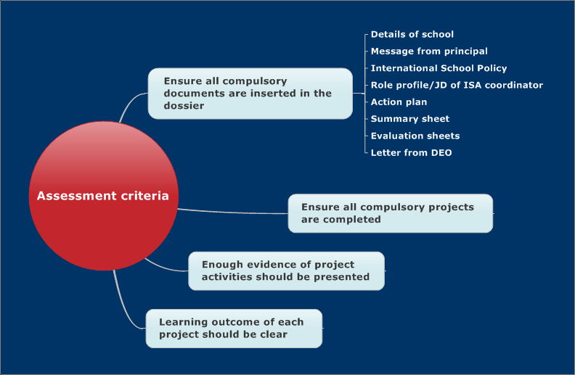

Slide 22
Lets break for 5 minutes

Slide 23
Collaboration in depth

Slide 24
International activity
International activities = International focus of any kind. Additionally they should be:
Curriculum based with content that complements the school’s plan.
Contributing to improving educational outcomes and skills for 21st Century.
Both schools on either side should learn from the involvement and not just exchange project activities.
Encouraging young people to show awareness of other cultures and countries
Encouraging young people to explore the differences and similarities between their local community and that of their partner school
The teaching of a foreign language becomes a valid international activity when young people learn the language and about the other country, its customs, geography or culture and can compare and contrast with their own country.

Slide 25
What is (and isn’t) an international collaborative activity
A collaborative activity involves the pupils and teachers from school in Nepal and at least one international partner school.
It addresses issues relevant to all partners and has mutual beneficial learning outcomes:
Do we have to visit the partner school ?
NO !
Visits and trips (non-reciprocal) are acceptable provided that they are part of genuine curriculum work and young people have exchanged cultural information via e-mails or letters with their peers in the partner school before and after the visit.
This depends on the capacity of the school. We do not encourage this because this entails a lot of Child protection risks.
We will not judge schools based on their capacity to have foreign visits.

Slide 26
What is (and isn’t) an international collaborative activity
Visits and trips (non-reciprocal) are acceptable provided that they are part of genuine curriculum work and young people have exchanged cultural information via e-mails or letters with their peers in the partner school before and after the visit.
This depends on the capacity of the school. We do not encourage this because this entails a lot of Child protection risks.
Exchanges and work experience of Teachers or Head Teachers (reciprocal) are acceptable provided that young people have exchanged project information via emails and letters with the same school
We will not judge any schools based on their capacity to have foreign visits for students or teachers.
.

Slide 27
Activities suitable or not suitable for an ISA projects ?
School visits which are not clearly linked to the curriculum (for example a picnic trip to Chobar or a visit to a place of worship that does not have some curricular preparation or follow-up
Charitable fundraising which is not related to curriculum work (for example supporting a relief operation for COVID victims.
Activities which take place wholly outside of school hours (such as lunch time clubs) and are not related to classroom activities
Activities involving very few pupils like project with 5 students.
Lunchtime or after school clubs
Notes:
When carrying out any assessment of preceding work (Foundation, Intermediate and Impact Assessments) or of planned work (Action Plans) please be especially aware of activities which cannot be considered as eligible for the ISA. The British Council provides some guidance but briefly these include:
School visits which are not clearly linked to the curriculum (for example a ski trip or visit to Disney Land in France) or a visit to a place of worship that does not have some curricular preparation or follow-up
Charitable fundraising which is not related to curriculum work (for example supporting a disaster emergency appeal without an assembly or bulletin board on the school website which explains the background)
Activities which take place wholly outside of school hours (such as lunch time clubs) and are not related to classroom activities
Activities involving very few pupils
Lunchtime or after school clubs

Slide 28
Activity
SN | Activity | Y/N
1 | In-country visits to see each other’s heritages and enjoy.
2 | Email exchanges sharing photos of each other’s schools
3 | Sharing of gifts with each other
4 | For a project on environment, finding out about waste management processes in each other’s countries and writing an essay

Slide 29
Activity
SN | Activity | Y/N | How to make these collaborative
1 | In-country visits to see each other’s heritages and enjoy. | N | Share and learn about something concrete
2 | Email exchanges sharing photos of each other’s schools | Y | Photos can be for a particular activity that have tangible learning outcomes
3 | Sharing of gifts with each other | Y | Can be related to a cultural aspect and students follow this up with a written activity on the same topic
4 | For a project on environment, finding out about waste management processes in each other’s countries and writing an essay | Y

Slide 30
5 | A picnic which both partner schools attend together
6 | School to school development projects and teacher to teacher visits where learning are shared with each other.
7 | Learning to draw the flags of each other’s countries.
8 | Learning to play each other’s musical instruments and performing at a school function.

Slide 31
5 | A picnic which both partner schools attend together | N | The picnic can be tied to a research activity or a field visit
6 | School to school development projects and teacher to teacher visits where learning are shared with each other. | Y&N | This is also a collaborative activity for teachers where learning has taken place. If the learning is cascaded down to students and students follow that up with another activity then this will become a collaborative activity for ISA.
7 | Learning to draw the flags of each other’s countries. | Y | The students can then follow that up with a written report or other activities in relation to geometry or colors,etc based on the class
8 | Learning to play each other’s musical instruments and performing at a school function. | Y

Slide 32
Understanding 20% Local Curriculum
The study which carries local ethos and values prepared by local expertise in low cost is local curriculum.
Issues which are not addressed by central curriculum is addressed by local curriculum.
Practical, independent and behavioural study.
20% Local Curriculum is set from grade 1 to 5 by Curriculum Development Centre(CDC),Government of Nepal.
80% is taught from the text and for remaining 20%, teacher should design curriculum addressing local ethos then prepare action plan and finally the project is done.
It covers three subjects: Social Study, Creative Arts and Physical Education.

Slide 33
Subjects covered and possible projects
Social Studies: Cultural, historical, geographical, natural, religious, economic, ethnic caste/language, tourism, occupation, health, environment, educational and others.
Creative Arts: Any typical visual art, local songs or dances, musical instruments.
Physical Education: Any typical games or specific games related to any local melas, jatras or festivals

Slide 34
General topic areas for 20 % LC topics relevant to Nepal
Agriculture - Tea/ Coffee farming, farming of Cardamom, fruits, vegetables , etc.
Poultry or cattle farming – Cow farming, Sheep, Ostrich, etc
Small scale industries – Dhaka, Karuwa, Sukul, dalo, gundri, local cloth manufacture,
industries making incense sticks, carpets, etc.
Tourism – Training to guides, development of tourist places, trekking, mountaineering, rafting, etc
Other areas for livelihood generation- Homeopathic/ Ayurvedic medicine manufacturing, skills development,
computer trainings, electronics repair, driving, plumbing, etc.
Geography - landscape, weather, etc.
Religious, environment, transport, health and cleanliness, etc can also be explored.

Slide 35
20% LC incorporates
Local Needs
Local Contents
Local Participation
Local Knowledge/ Skills / Experts
Local Materials

Slide 37
Important things to consider while drafting the 20% LC plan
Consider the time allocated for local curriculum as directed by the National Curriculum.
Calculate how many hours you can bring in a week based on the total academic hours and based on this, evaluate how many topics or lessons to include.
Calculate the actual time required to teach a lesson ( Path/ Akai) and allocate time for 20% LC accordingly.
Based on number of working school days, prepare lesson plans to deliver, as well as consider the evaluation time that is required and evenly distribute work for 20 LC for the chosen subject.

Slide 38
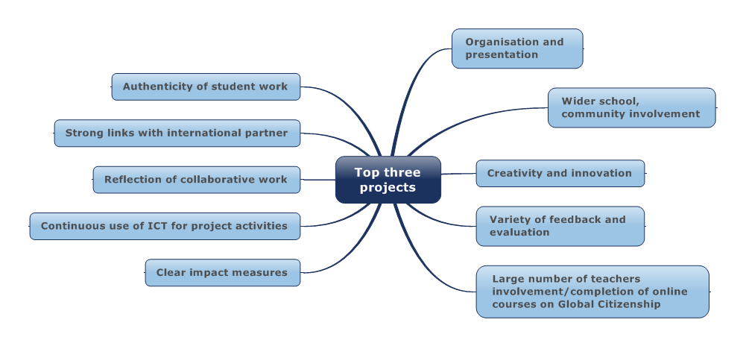
A Good project would include

Slide 39
Evaluating Learning Outcomes
Evaluation forms. These include different forms for pupils, parents, teachers and visitors. (British Council will provide these and at least two different types are mandatory)
Surveys
Assignments or worksheets (this includes homework and classwork)
Quiz competitions
Essay writing
Debates
Elocution
Evaluation doesn’t need to be Limited to these tools. You can use any method to evidence learning in your students.
Notes:
Refer to Pages 18-24 of the Guidance Manual

Slide 40
Mandatory documents required for Action Plan Submission
ISA action plan (sections 1-4) signed by the head teacher and stamped
ISA coordinator Job description
International Policy
20% local curriculum document
Audit Template
British Council’s Child Protection Policy and Code of Conduct
British Council’s GDPR
You will submit later :
Impact Evaluation form
Notes:
Show them the SAMPLE.

Slide 41
A look into the Guidance Manual: https://www.britishcouncil.org.np/programmes/education/connecting-classrooms/international-school-award

Slide 42
Break ?

Slide 43
ISA Impact Video : https://www.youtube.com/watch?v=Q7dpcxAaf4w&t=3s

Slide 44
Let’s Recap

Slide 45
1. How long is the ISA award valid for?
3 years
2.What is the full form of SDG?
Sustainable Development Goal
3. What min % of pupils should be engaged in the ISA programme?
75%

Slide 46
4. How many international collaborative projects are mandatory?
3
5. Name three areas that can be covered in a local curriculum project under culture.
Festivals, music, costumes, songs, skills etc.
6. Name any two British Council forms that are used for evaluation.
Pupils evaluation forms, parents evaluation forms, visitors evaluation form, teachers evaluation form

Slide 47
7. Which subjects can 20% local curriculum cover?
Social studies, Physical Education, Creative Arts
8. What are the two mandatory British Council documents that schools need to sign before they start ISA?
General Data Protection Regulation Policy and Child Protection Policy Document
9. What’s a dossier?
A portfolio of evidence containing all the work done for ISA.

Slide 48
10. How long is the ISA journey?
12 months.
11. Who are BCSAs?
British Council School Ambassador. They provide support and mentoring to schools on their ISA journey.
13. What are the compulsory projects?
3 collaborative projects with international partner, 2 in-school projects with an international dimension, public-private partnership with an international dimension and 20%Local Curriculum with International Dimensions.
Notes:
Show them the SAMPLE.

Slide 49
British Council Role
Introducing the ISA concept
Reviewing Action Plans and giving feed back
Organise Schools online & CPD training
Mid year review and dossier guidance
Monitoring a small sample of schools
Convening the Assessment Panels
Recommendations & Feedback to schools
Organising the ISA ceremony
Maintaining the Support system through ISA ambassadors

Slide 50
Timelines - indicative
ISA Training s roll out
Deadline for submission of Action Plan : 21 days from the date of orientation completion
Where : connecting.classrooms@britishcouncil.org.np
File size should not exceed more than 6 MB in total. You can zip the file to reduce its size.
Assessment of Action Plans completed by : Minimum 15 days from the date of action plan submission.

