Slide 1
Information Session
May 2025
Connections Through Culture Grants 2025
Notes:
Please add Date:

Slide 2
Housekeeping
    We expect the session to be around between 1 hour and 1 ½ hours – dependent on the number of questions you have
    There will be a presentation for around 40 minutes, and the rest of the time will be for Q&A;
    This is one of 4 information sessions running across the first 2 weeks in May.
    A recording will be shared with you via email and on the British Council channels after all the sessions have been delivered;
    So that you can see and hear the speakers clearly, you will automatically be placed on mute with your cameras off.
    During the presentation, if you have any questions, you can submit them using the Q&A function
    During Q&A, if you have any questions, please use the raise your hand function and allow us to call on you to unmute yourself before asking your question;
    This session will be recorded. If you do not wish to be recorded, please continue to keep your video off and microphone muted during the Q&A.
    If you are interested in applying for this grant – you must have a good level of English or have support from someone with a good level of English (a translator or interpreter) when needed, to ensure smooth communication.

Slide 3
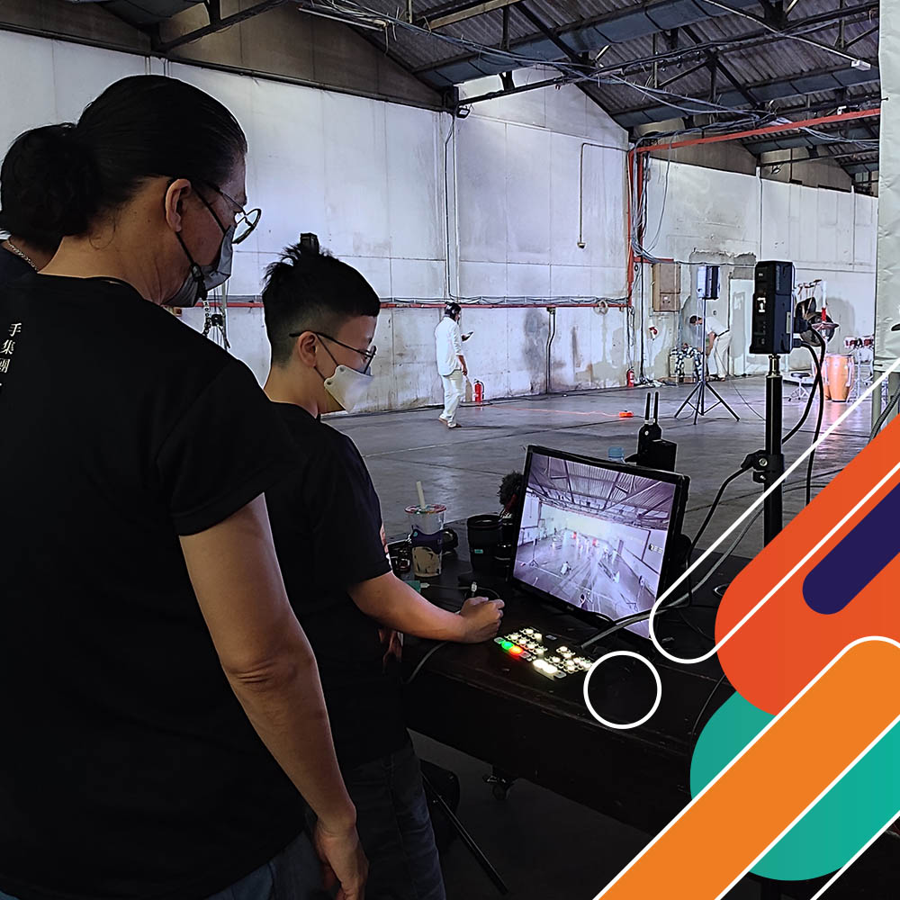
What is Connections Through Culture?
    Connections Through Culture Grants are open to:
        Artists, cultural professionals, and creative practitioners
        Art and cultural organisations, hubs, networks, and collectives.
    The primary objective is to support new connections, exchanges, and collaborations between the UK and participating countries in arts and culture.
    These grants support UK and participating countries’ applicants to work collaboratively on digital, face to face, and/or hybrid artistic projects.
    For projects between October 2025 to October 2026.
    Application deadline: 23 June 2025 (15:00 BST)
Notes:
Connections Through Culture is a grants programme run by the British Council in the UK and participating countries. We are very excited to have new countries taking part in CTC this year.
In addition to Asia Pacific countries we also have e.
This programme aims to develop exciting cultural exchanges and collaborations between artists, arts professionals, and arts organisations, and to support long-lasting relationships between people from Asia-Pacific and the UK.
The 2024 Open Call is accommodating applications from the UK and Asia-Pacific countries: Australia, Bangladesh, the mainland of China , Indonesia, Malaysia, Myanmar, New Zealand, Philippines, Sri Lanka, Thailand and Viet Nam.

Slide 4
What is Connections Through Culture?
Participating Partner Countries | Grant Value
Australia, New Zealand | Up to GBP 5,000
Bangladesh, the mainland of China, Indonesia, Malaysia, Myanmar, Philippines, Sri Lanka, Thailand and Viet Nam | Up to GBP 10,000
NEW FOR 2025 Nepal Armenia, Azerbaijan, Georgia, Kazakhstan, Turkey, Ukraine and Uzbekistan
Open to individual artists, cultural professionals, creative practitioners, or, for cultural organisations, hubs, networks, and collectives based in the UK or in any of the eligible countries listed above.
A project Lead Applicant must be agreed among UK partner(s) and participating country partner(s).
Grants are offered to applicants in all art forms: theatre, dance, visual arts, literature, film, music, architecture, design, and fashion. Cross-disciplinary practices are encouraged.
Who can apply
Notes:
Definitions:
Lead Partner – name will be on grant agreement, will manage budget and timeline of whole project.

Slide 5
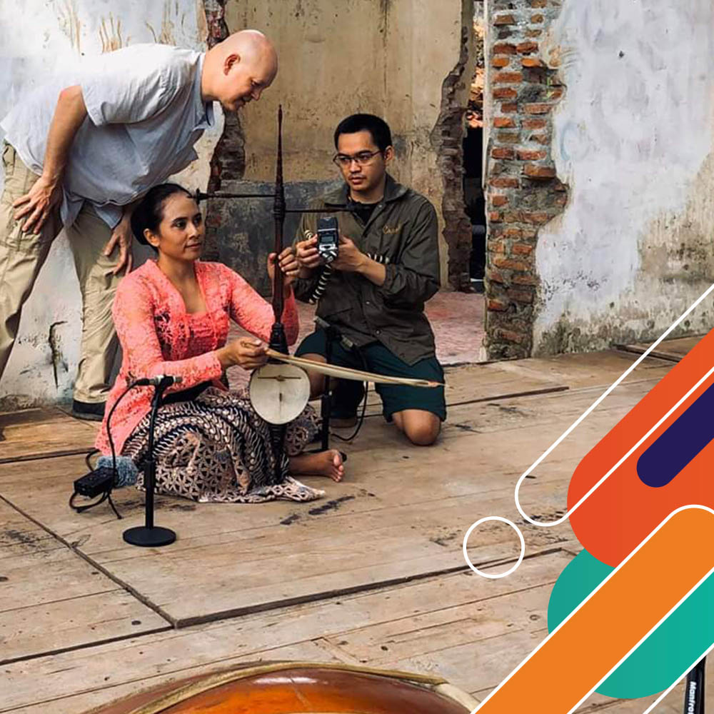
What can the grants be used for?
    The delivery of projects can be digital, face-to-face, or a hybrid blend of both. Various approaches can be employed, for example:
Residencies
Exhibitions, festivals, showcases, workshops, performances, screening programmes
Projects which focus on or include digital innovation (such as projects which combine art with technology in a new or different way)
Conferences, panels and talks
Creative use of archives
Research and development of future project ideas
Publications
Notes:
This is not an exhaustive list. We are first and foremost interested in the collaboration between partners.
The primary focus should be on the collaborative nature of activity between partners within the project rather than producing and distributing a finished product.
Your application will be reviewed on the merit of the collaborative activities first and foremost. We won't support projects whose primary focus is commercial.

Slide 6
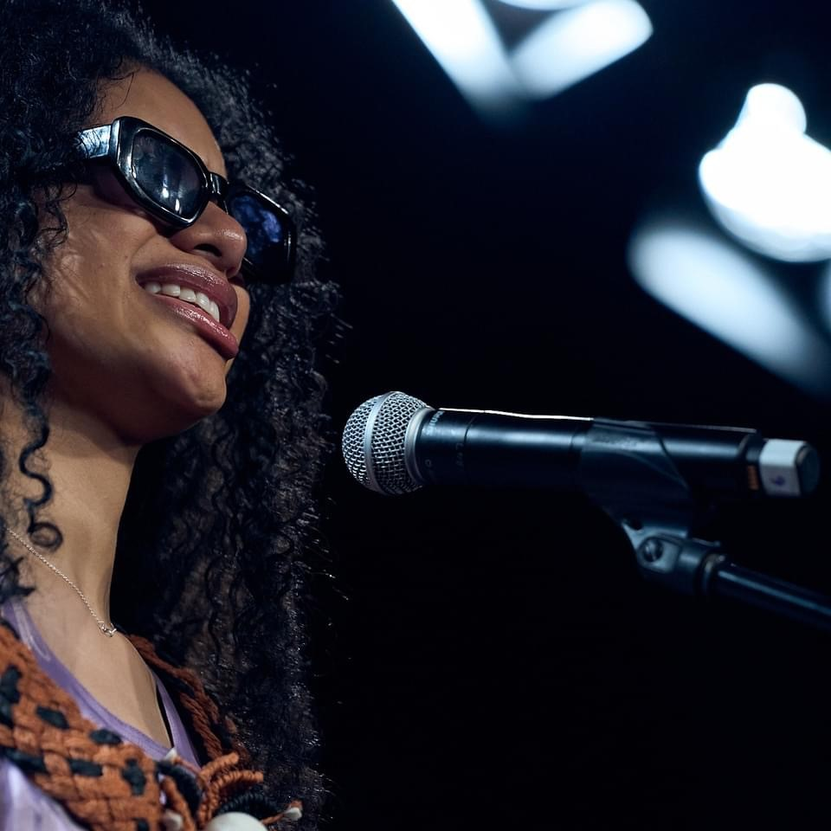
Key Themes
The grant will support the process to develop new projects with artistic expression or creativity at the core and that will result in collaborative activities including artistic and creative exchange of either skills, knowledge and practice or the co-production towards new artistic and creative content.
While we accept applications covering all artforms and outcomes, applications that respond to the following priority themes may be prioritised during final decision-making:
Diversity and Inclusion
Climate Change
    ​
Notes:
Projects can address any subject or theme.
We want to support a range of projects and organisations/individuals that reflect a breadth of geographical locations, art forms and themes across participating countries and the four nations of the UK. We will consider this when assessing your application against others.

Slide 7

Eligibility conditions
A complete application (including CV if applying as an individual) should be received by 23 June (15:00 BST) via the Good Grants application site.
Each application must comprise of at least one (1) UK partner and one (1) partner from the participating countries.
Organisations and Individuals can apply
Project proposals should have a timeline ending no later than 31 October 2026.
Notes:
3. Can project delivery by a grantee team be extended beyond 31 October 2026?
Ideally, we want you to finish the grant project by 31 October 2026, however we may consider extensions on a case by case basis.
Individuals
For the UK, eligible individuals are those living and working in the UK and for participating countries, individuals need to be residents of that country.
We would expect individuals to have the necessary registration/s needed to comply with legal and/or tax provisions in the country in which they are based e.g. this could be a sole trader or an individual operating as a company with the associated registrations.
These could include, but are not exclusive to:
Artists and Practitioners
Individuals who produce works in any art form, such as performers, writers, filmmakers, designers, or curators.
Creative Entrepreneurs
Individuals who are self-employed or have established a business within the creative industries.
Arts Organisations
Must be registered in the country in which they operate.
These could include, but are not exclusive to:
Artistic, Creative, or Production Companies and Collectives
A production company, house, studio, or team that provides the physical basis for works in performing arts, new media art, film, television, music, radio, comics, interactive acts, video games, websites, or videos. Creative/artistic companies or collectives can also include formal or informal groups of artists collaborating around a shared art form, ambition, or purpose.
Arts Venues
Places dedicated to promoting artistic practice by providing infrastructure for performance, exhibition, or creation.
Exhibitions, Festivals, and Seasons
Temporary or time-bound cultural events occurring at a specific time and/or place, focusing on a particular art form or theme. These can be recurring or one-off events.
Creative Hubs
Physical or virtual spaces that bring creative people together. Hubs serve as convenors, offering networking opportunities, business development support, and community engagement within the creative, cultural, and tech sectors.
Can Universities / educational institutions apply?
Yes, but we want to prioritise arts organisations and individuals. Applications from universities and educational institutions will need to demonstrate their primary arts and cultural focus in the ‘Tell us about you’ question and demonstrate how their arts and cultural focus in their proposed project is not just for academic research purposes.
Can newly registered organisations apply?
You can apply if your organisation is newly registered. We will consider each organisation’s ability to deliver the project as part of the assessment. We will also carry out ethical and credit checks as part of our due diligence for successful projects.

Slide 8
Eligibility conditions
Proposed projects must be projects for the arts, cultural or creative sector(s) within any of the following art forms:
        Architecture, design & fashion (including craft)
        Creative technology (including games, extended reality, immersive, mixed, augmented and virtual reality)
        Film
        Literature
        Music
        Theatre and dance (including circus)
        Visual Arts
Notes:
Please note that you must only select one art form on the application form.
If your project delivers activity across multiple art forms, you will need to select only one. This is so that it can be allocated to the most appropriate team member for assessment.
Assessors will notify the CTC team if another art form expert is needed to contribute to the assessment process.

Slide 9
Eligibility conditions
We welcome proposals for:
        Cross-art forms projects
        Projects with themes relevant to the creative economy
        Cross-disciplinary art projects (e.g., art + science, art + technology)
Funding Bodies are not eligible
Notes:
We want to support a range of projects and organisations/individuals that reflect a breadth of geographical locations, art forms and themes across participating countries and the four nations of the UK. We will take this into consideration when assessing your application against others.
We are keen to receive applications from partners we have not previously worked with, especially including applicants working with partners outside London.

Slide 10
Selection Criteria
Quality and artistic/creative merit | The project demonstrates strong high artistic/creative quality relevant to the context in which it is delivering. The project demonstrates applicants’ previous track record of delivering and developing high quality work | 25%
Partnerships and Collaboration | The project fosters meaningful and equitable collaboration between UK and country partners. There is clear evidence of mutual benefit. Roles and responsibilities between partners are clearly defined | 25%
Feasibility and Project Management | The project is realistic, well-planned, and achievable within the given timeline. The budget is clearly justified and equitably distributed between partners. The project has considered risk and put in strong risk mitigation plans | 25%
Notes:
Criterion 1:
Want to be confident that you and your partners have a track record in delivering quality work and/or have plans in place to make sure high standards across the project
Criteria 2
In defining ‘mutually and equally benefitting’ and ‘equitable use of budget’, We want mutual benefit to partners:
Not mutual: Having Counterpart/s only as guest speakers to the activities or would just take part in some activities of the whole project. This will be subjective. We can recall how previous grantees did mutual work for projects.
Criteria 3:
If costs are heavy on one region because they will do local travel or on-site production, then there should be proof in proposal that Counterpart in other region is financed equitably.
Lead Partner is budget manager. There have been instances in last FY’s grantees that budget management itself had some disparity since Lead Applicant is the one shouldering most costs. It’s incumbent in the Scoring Process to check balance of tasks between Lead and Counterpart.
We also understand that supplier rates (such as language interpreter, translator) is not at parity between the UK and participating countries. Professional fees also vary across participating countries

Slide 11
Selection Criteria
Audience/Participant Engagement and Impact | The project clearly defines its intended audience and/or participants and outlines strategies to reach them effectively. (For research and development projects this could be demonstrated as part of future activity beyond the RND or how thinking about audiences/participants has influenced the project’s design and activity.) The project articulates its intended impact and how success will be achieved assessed, considering engagement, outcomes, and relevance. The project considers the potential legacy of the project (proportionate to the grant amount received) | 10%
Diversity, Inclusion and Environmental Sustainability | The project demonstrates a commitment to equality, diversity, and inclusion. It creates opportunities for underrepresented groups or communities. It considers environmental sustainability in its design and delivery. | 15%
Notes:
Criterion 4
Want to know that you've considered how your projects will be shown to others be that an audience, or if work in progress amongst peers. We want to support projects that have thought about the impact of their project specific to their locations and this impact be achieved, and assessed.
Criterion 5:
We are keen to support projects that are in line with our EDI values/ways of working. There is more supporting information on this in the guidance toolkit and FAQs

Slide 12

Grant Timeline
Application:
The application portal will close on 23 June 2025, at BST 15:00.
All applications must be made through the Good Grants website. (Applications are open now.)
Assessment:
Your application will be assessed by the British Council in July and August 2025.
Announcement and Confirmation of Acceptance from Grantee:
We aim to let all applicants know the outcome of their applications via email by mid August 2025.

Slide 13

Grant Timeline
Contracting:
Successful applicants will sign a British Council Grant Agreement. Payment will be made 30 days following receipt of each invoice. There may be specific payment conditions per country.
Grantee Orientation:
British Council will have an Orientation Session for Grantees, covering all requirements for grant project delivery in October 2025.
Grant delivery:
While you deliver your grants from October 2025 – October 2026, British Council staff will be in communication with you for support and progress updates.

Slide 14
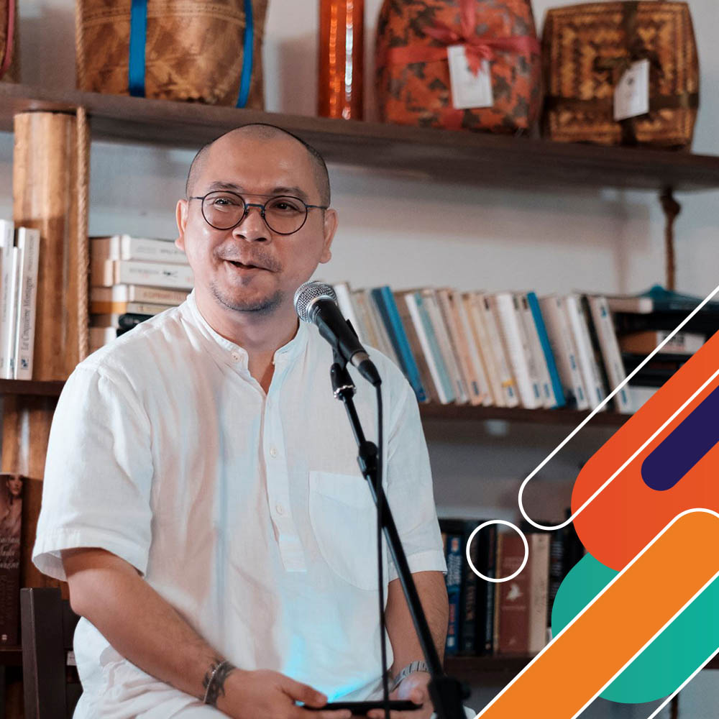
Grant Timeline
Grant Project Completion:
The grant activity must be completed by 31 October 2026.
Reporting:
The project completion report should be submitted within 30 days of the end of the project. For projects longer than 6 months, an interim report should be submitted by end of month 5 of the project.

Slide 15

Reading through the Application Guidance Toolkit and Frequently Asked Questions
How to apply?
→ Read the Application Guidance Toolkit and Frequently Asked Questions
→ Speak to possible partners
→ Form your collaborative project idea
→ Plan time to complete the Good Grants application form (in English)
    Rule of thumb: Always read through the guidance very carefully. If in doubt about anything, go back to the guidance.

Slide 16

Applying through the Good Grants portal
The link is on the Application Toolkit and on the British Council CTC webpages of the eligible countries.
What to do:
Create a (free) Good Grants account. You can’t view the application form until you have a Good Grants account. It might be advisable to keep an offline copy of your answers in case of any unexpected technical issues.
Please tick 'I agree to receive notifications and communication emailed or SMS' so you can receive updates and important messages from the CTC team
If there are questions/concerns in creating a Good Grants account, please check the Help pages and support email of the platform or contact us at https://forms.office.com/e/rdFpf1c46e
Consent: You need to agree to the Privacy Notice to proceed. This states we keep and share your information for the purposes of the grant application, and if you are selected, for the whole duration of your grant project delivery.
Notes:
Good Grants is the external website for all applications for the CTC 2024 grants. This is a new platform
A copy of all application questions is available on the BC CTC website

Slide 17
Completing the application
What to prepare:
Almost all questions for new applicants and previous grantees are the same. Yours and your partners’ contact details will be required.
CVs for any applications with Individuals . Please prepare ahead.
The Good Grants platform lets you save your application draft as you go along. You can also edit a submitted application, up until the deadline To check these changes have been made, please review the form itself or check the pdf as you won't receive an automated email.
The Good Grants application form has collaboration enabled so you will be able to invite your project partner to collaborate on the application – once you have completed the first 'Category' section you will be able to invite others using the plus sign to the right of your initials in the middle right of the screen.
The application must be made in English.
Notes:
Some technical notes to highlight when using Good Grants
The Category question is required so that you are prompted with all the relevant questions applicable to your project and your partner/s location.
There are some instances in the application form where we have provided country- specific information that only applies to particular applications with specific country partners.
You can find out more about these specific instances in the Guidance Toolkit document.
Please select the country where the non UK partner is located.
Application name: this will auto fill as the applicants name
Some tips to help you complete the application form:
You will only be alerted to any gaps in your application when you come to submitting your application.
To help make submission easier, please pay attention to your word count as you go and please make sure to answer all compulsory questions.
All questions are compulsory unless indicated as optional
If you make a mistake at the Eligibility section you will need to start a new application
When you get to the budget section – the table does not have the functionality you may be used to in excel so you will need to double check the totals you are entering as the tables do not auto sum these cells

Slide 18
Completing the application
What to prepare:
Your proposal! Review the criteria.
        What are you going to do? How and why are you going to do it?
        When and with whom will you be doing the activities?
        What is the impact your project is trying to achieve?
        What is your project plan and timeline?
        Budget: This needs to be in GBP (Great British Pounds). You will need to input any other income that may be confirmed or pending
        You will need to explain how the budget is split across the partners and will need to include which country each item in budget will be spent and which partner is holding that part of the budget
Notes:
We do not require match funding and can support 100% of project costs

Slide 19
Completing the application
What to consider:
What makes a good collaborative partnership?
        Are your values and ways of working aligned?
        Do you think you can both work regularly and equitably during the project timeline you are proposing?
        If you are selected as a project team (with you as Lead Partner), British Council staff in your participating country will be your first point of contact for support for risks and issues with your delivery, timeline, budget, partner, and other stakeholders.
2. Intended/targeted reach of your project
        Who are your target audience and/or participants? Or how have you thought about any future audiences/participants if your project is at an earlier stage in its development
        How many audiences or participants do you expect- either face to face or online?
    Note: Not all grant projects will have public audiences or participants. The way you communicate your project depends on your objectives.
Notes:
If we need to give examples of online platforms:
Websites (e.g. for writing/blogging, virtual exhibition rooms, archiving, livestreaming)
Social media platforms such as Facebook, Twitter, Instagram
Online communication/collaboration platforms such as Zoom, Teams

Slide 20
Completing the application
What to think about:
Access support
      We ask all applicants to embed audience accessibility into their projects, explain what your project will do to address this, include any accessibility costs in the budget proposal, and give reasonable justification.
      If an applicant has accessibility requirements for the delivery of their proposed project (eg. personal access costs for the individuals involved in the project planning, design and delivery), they will be able to request additional funds beyond the core grant in the budget section of the application form. These costs are not guaranteed, although we will do everything we can to support your needs.
      If you are disabled or have a long term health condition, you are welcome to contact us at https://forms.office.com/e/rdFpf1c46e for possible support we may offer to assist with making your application.
  Note
  There are the British Council policies and requirements should you propose activities which involve Children or Vulnerable Adults, Equality, Diversity and Inclusion, Environment Sustainability. (Please refer to details in the Application Toolkit and Frequently Asked Questions)
Notes:
Accessibility support WHILE applying: We explain that exceptionally IF the applicant can’t apply through Good Grants, we are happy to explore how we can support/alternatives. (Last year, we have accepted one applicant to submit budget form through email and paid fee for a supporter to help him completing the application. But let’s ask them to approach us and we will handle case by case since the support need can vary.)
Accessibility support as part your proposal: Let us reiterate that accessibility costs should already be integrated in their budget proposals. Let them think ahead of possible support they need for their projects.
Accessibility support WHILE planning, design and delivery: Personal access costs for the individuals involved in the project planning, design and delivery should be included in your application form. These costs are not guaranteed, though we will do everything we can to support your needs.
Remind applicants that if their proposal is accepted, they need to abide by our SAFEGUARDING policy. As experienced in ID and MY last year, police clearances or checks were requested, as well as other proofs of identity.

Slide 21
Submission & Enquiries
All applications must be submitted through the Good Grants portal by
15:00 BST on 23 June 2025 ​
​Any enquiries about the application process can be sent to:​
https://forms.office.com/e/rdFpf1c46e
For technical support with the application platform, please refer to the Help page on Good Grants.

Slide 22

Examples of CTC projects
Grantee:
Catama Borneo and Borneo Boat Lute Revival collaborated with Pitt Rivers Museum to delve into museum collections, investigate cultural artifacts and breathe new life into the archives. By shedding light on the ongoing practices and preservation efforts of the boat lute in rural and urban communities across Borneo Island, they aim to amplify indigenous voices and reimagine the role of databases and archives.
'The Archived is Alive' between the UK and Malaysia

Slide 23
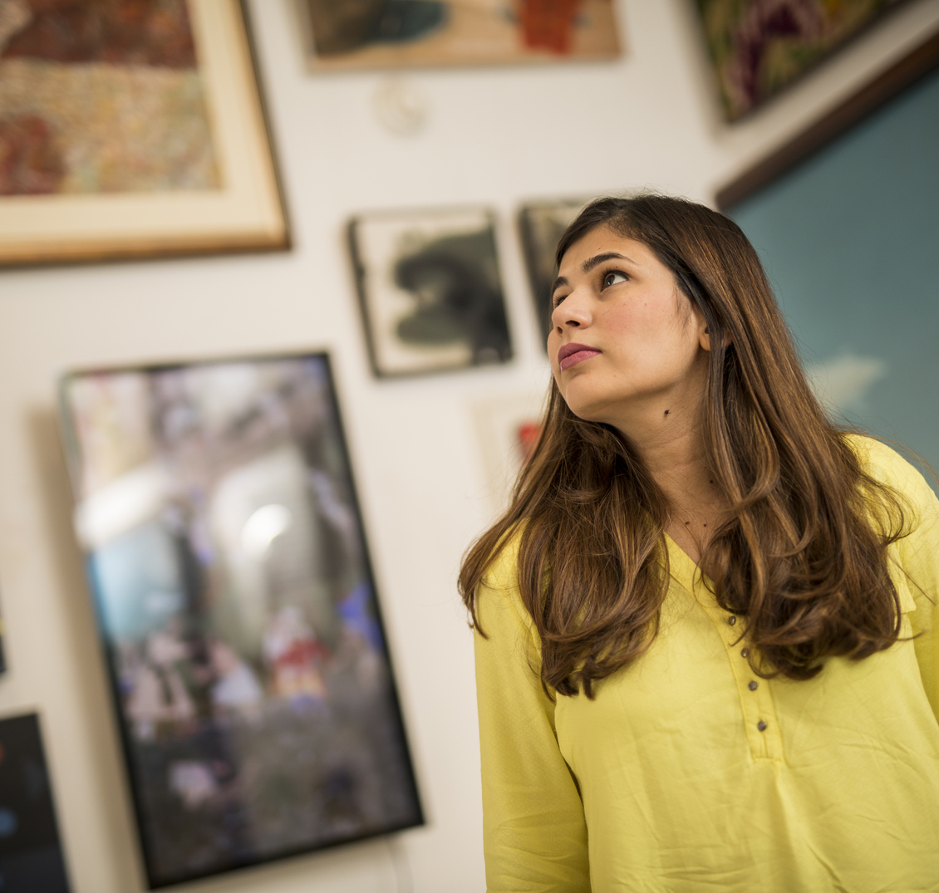

The Safe Space
    Through the Connections through Culture (CTC) grant, Dr Aung Min, based in Myanmar, collaborated with Tony Gammidge in the UK about using art with people who have suffered from trauma and mental health problems. They exchanged working practices in animation, drawing and photography and created new work about food.
    This resulted in an exhibition in Yangon attended by 200 people, networking between Saferoom artists, youth in Myanmar and the international community. A collaborative virtual ‘Community Table’ was set up with Art Refuge, a UK based charity working with refugees, which included drawing exercises and an exchange about a unique approach to working with trauma using art and community.
  CTC opened up opportunity for networking and learning between Saferoom artists and youths, artists and the international community.
    Dr Aung Min
  ‘

Slide 24
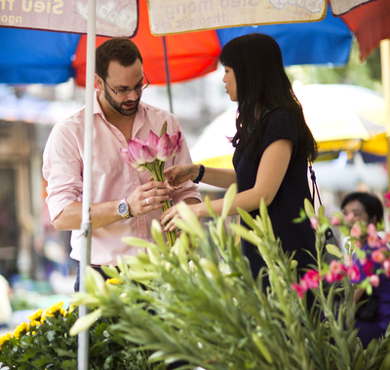
A tale of two flower markets: Bangkok–London
    January to March 2022 / Bangkok
    Through the British Council’s Connections through Culture (CTC) Grant,
    Dr Tovivich, a UK alumni, revived the struggling Pak Khlong Talat flower market in Bangkok, inspired by the innovative approach of Columbia Road Market in London. She helped transform a social space and catalyse business opportunities. The exchange resulted in two photo exhibitions over nine days from the two flower markets, telling stories of the daily lives of people, traders and revealing the innovative ways of using the space, creating a virtual dialogue between the two markets.
    31,000
    visitors to the photographic exhibitions
    82%
    of which were young people
    18.7%
    of which were first time visitors to the markets
    4.9 million
    THB in revenue
  ‘
  Connections Through Culture has helped to transform the Bangkok flower market in a positive way, leading to new business opportunities for local artists and a new level of creativity with the community.
    Dr Supitcha Tovivich, Assistant Professor at Silpakorn University

Slide 25
More questions?
Review the Toolkit and FAQs
Contact us at:
https://forms.office.com/e/rdFpf1c46e
Notes:
Please remind people to refer to the Toolkit and FAQ again which they can download from British Council country web pages.

Slide 26
Thank you and good luck!

